Slide 1




THE LATEST INNOVATIONS

Slide 2
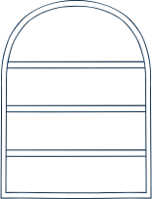







Nicole Estevez
MEET THE TEAM
Chanodome Tingpattan
Lucas Sotkovszki
Michael Holmes
Janati Nakimera

Slide 3

LAVAZZA AT A GLANCE...
01
02
03
04
From a Small Shop to a Global Brand
Innovation in Every Cup
More Than Just Coffee
A Smart and Sustainable Supply Chain
Lavazza started as a small family business and grew into Italy’s top coffee brand, now sold in 90+ countries
Introduced coffee blending, vacuum-sealed packaging, and capsule systems
Lavazza serves hotels, restaurants, offices, and businesses with professional coffee solutions
Five production plants and coffee sourced from 25 countries

Slide 4
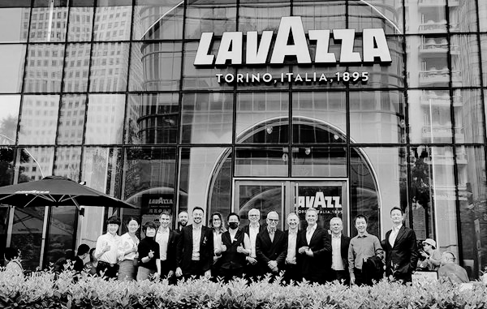
KEY CHALLENGES
A single central warehouse led to higher transportation costs due to reliance on Less-Than-Truckload (LTL) shipments and long-distance deliveries. This also caused service and delivery delays, impacting customer satisfaction as fulfillment times increased for distant locations.
Additionally, the warehouse was operating at full capacity, making it harder to scale and meet growing demand. Lastly, the centralized approach limited flexibility, restricting Lavazza’s ability to adapt to regional demand shifts, disruptions, and future expansion opportunities.
01
Rising Transportation Costs
02
Service & Delivery Delays
03
Warehouse Capacity Limits
04
Lack of Flexibility

Slide 5

OBJECTIVE FUNCTIONS & CONSTRAINTS
As a result, a linear programming model was developed to reduce total transport costs through a partial reorganization of the network.
Model 1
Model 2
Location 2 (Best Location): The objective of this model is to minimize costs subject to the constraints.
Min(277.8𝑋72+814𝑋73+705𝑋74+349𝑋71+215𝑋76+460𝑋75+362x21+367x23+301x24+350x25+307x27+18(𝑋71+𝑋75+𝑋76+x74+x72+x73)+15(𝑋23+𝑋24+x25+x21+x26))
Location 6 (Best Location): The objective of this model is to minimize costs subject to the constraints.
Min(391𝑋81+307𝑋82+674𝑋83+500𝑋84+251𝑋85+0𝑋86+18(𝑋71+𝑋72+𝑋73+𝑋74+𝑋75+𝑋76)+20(𝑋81+𝑋82+𝑋83+𝑋84+𝑋85+𝑋86)+129(𝑋71+𝑋72+𝑋73+𝑋74+𝑋75+𝑋76))
Subject to: X71+X72+X73+X74+X75+X76 = 17600 (Total amount of demand at each location)
For locations that don’t have a central warehouse
IN = demand
X72+X21 = 2300
X73+X23 = 3000
X74+X24 = 5500
X75 + X25 =3000
X76 + X26 = 2300
For the new warehouse
X72 >= 1500
𝑋𝑖𝑗≥0 where 𝑖=1…𝑛 and 𝑗=1…𝑛 for all n
Subject to: 𝑋81+𝑋82+𝑋83+𝑋84+𝑋85+𝑋86≤17600
𝑋81+𝑋82+𝑋83+𝑋84+𝑋85+𝑋86=𝑋71+𝑋72+𝑋73+𝑋74+𝑋75+𝑋76
𝑋81=1500
𝑋82=2300
𝑋83=3000
𝑋84=5500
𝑋85=3000
𝑋86=2300
𝑋𝑖𝑗≥0 where 𝑖=1…𝑛 and 𝑗=1…𝑛 for all n

Slide 6
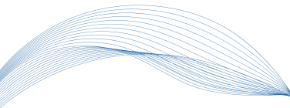



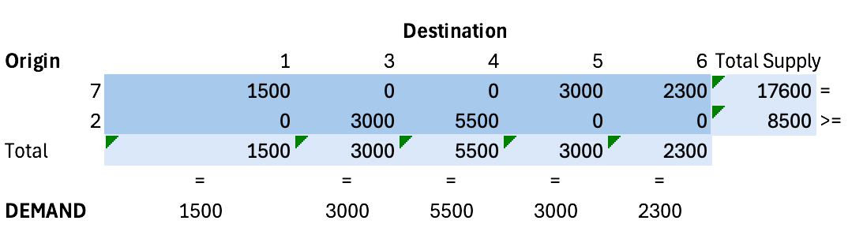
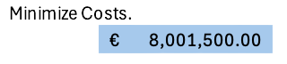

OUR MODELS
MODEL 1
Assumptions
New Warehouse
1
The model works by checking to see if it is cheaper to do a combination of three scenarios.
Scenario 1 ships all the supply directly from the central warehouse(7) to a location.
Scenario 2 ships all the supply to the new location and then from the new location to the customer.
Scenario 3 A combination of the two ships some supply from 7 to customer and then some supply from 7 to new location to customer.
The model will calculate the best possible routes to minimize cost while also meeting demand at each location by using a combination of all three of the above scenarios.
2
3000
3
5500
Supplies
10800 >=
4
Demand
1500
7
2300
6
17600 =
3000
Central Warehouse
5
TABLE 1: COST PER LOCATION
Notes:
This visualization accurately represents the logistics flow across all potential warehouse locations. The only difference between scenarios is the numerical values for shipments and allocations. Regardless of where the secondary warehouse is placed, the general structure of supply movement remains the same—starting from the central warehouse, distributing to the new warehouse, and then fulfilling customer demand. This standardized representation ensures clarity while allowing for easy comparisons between different model configurations.

Slide 7

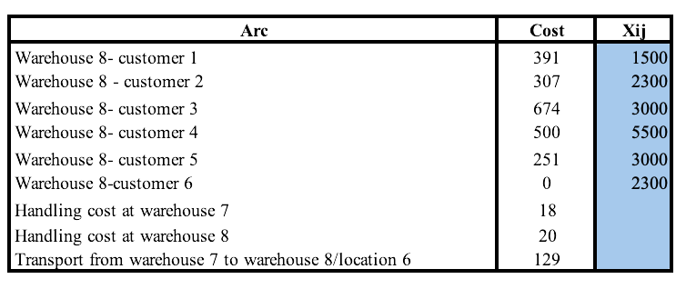
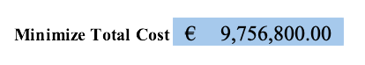
OUR MODELS
MODEL 2
Assumptions
The model developed established the appropriate location of the satellite warehouse, and which customers will be served with this new warehouse.
Seven cases were considered. The initial case study with only one warehouse in the distribution system was considered as the case at location 7.
In locations 1, 2, 3, 4, 5 and 6, scenarios were considered where the new warehouse was located at those locations, an analysis was done to give a result of the most optimum location of the new warehouse to meet the demand while minimizing costs.
A combination of these gave us the total cost function which was minimized to come up with the least cost location of the new warehouse.
It was assumed that all the supply is sent from the warehouse to meet the demand, leaving no extra units behind.
The LTL costs considered are the transport costs from a warehouse to the customer whereas FTL costs are the transport costs between warehouses.
In Model 2, the first warehouse remains in the distribution network and sends all the 17600 tonnes to the new warehouse. The new warehouse then supplies the units in tonnes to each customer to meet the demand.
New Warehouse
1
1500
6-8
2300
2
3000
Supplies
15300 >=
3
Demand
5500
7
3000
4
17600 =
5
TABLE 2: COST PER LOCATION
Notes:
This visualization accurately represents the logistics flow across all potential warehouse locations. The only difference between scenarios is the numerical values for shipments and allocations. Regardless of where the secondary warehouse is placed, the general structure of supply movement remains the same—starting from the central warehouse, distributing to the new warehouse, and then fulfilling customer demand. This standardized representation ensures clarity while allowing for easy comparisons between different model configurations.

Slide 8

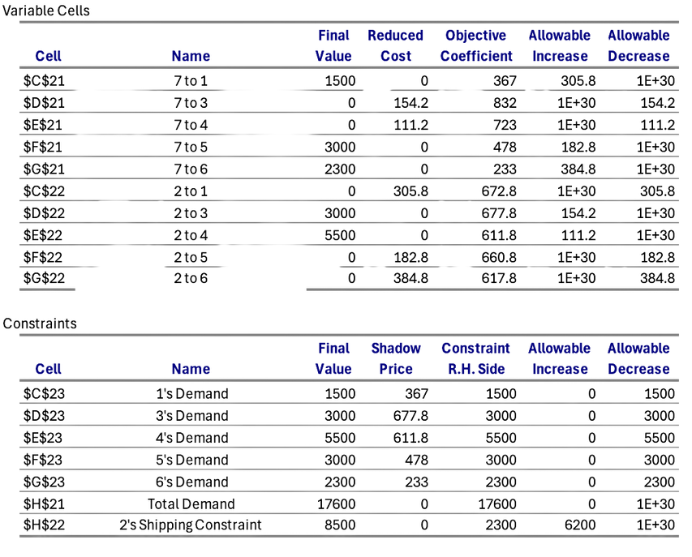
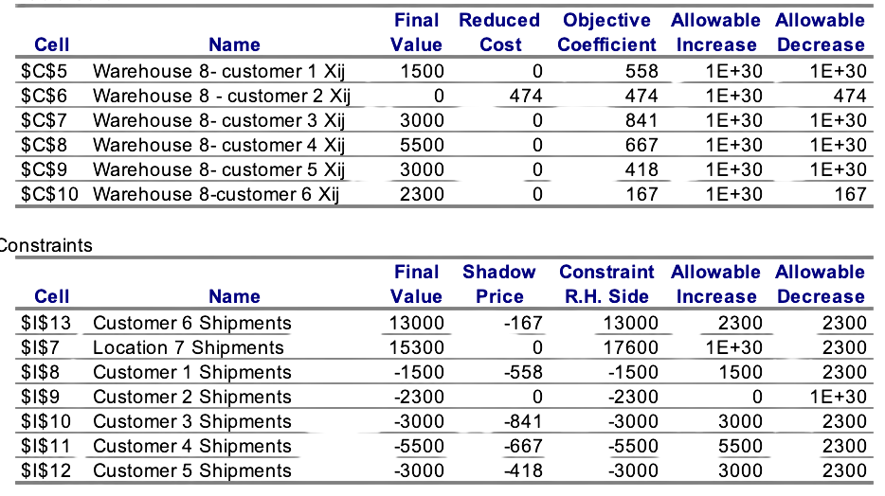
SENSITITY REPORT
MODEL 1
MODEL 2
Customer 3 and 4 have high shadow prices (-841 and -667) → Indicates these shipments are critical, and adding or reducing them would have a big cost impact.
Customer 6 has the lowest shadow price (-167) → Meaning shipments to this location have the least impact on total cost, making it a potential area for expansion.
Customer 2 and 1 have negative shipment values → Suggesting that in an alternative scenario, they should receive shipments from another warehouse or supplier.
Customer 3 & 4 have high shadow prices (677.8 & 611.8) → Shipments to these locations are costly, and any changes in demand will significantly impact total costs.
Customer 6 has the lowest shadow price (233) → Shipments here have minimal impact on overall costs, providing flexibility in adjustments.
Customer 1 & 2 show negative shipment values → Indicates they might be better served from a different warehouse, suggesting inefficiencies in current allocation.

Slide 9
RECOMMENDATIONS
02
03
01
Strategic Warehouse Expansion
Optimized Customer Allocation
Hybrid Transportation
Warehouse 2 (Model 1) will primarily serve Customers 3 & 4, ensuring balanced distribution while reducing congestion at the central warehouse.
This will improves efficiency by cutting excess transportation costs and reducing delays.
By prioritizing Full-Truckload (FTL) transport for bulk shipments, Lavazza can decrease the frequency of Less-Than-Truckload (LTL) deliveries, leading to fewer trips and lower fuel consumption. Research shows that FTL optimization can reduce transportation emissions by up to 30% (MIT Supply Chain Research).
To optimize logistics costs and service efficiency, Lavazza should implement a hybrid transportation model combining FTL for bulk shipments to a secondary warehouse and LTL for last-mile deliveries. This approach can reduce total logistics costs by 10-20% (Deloitte, 2023) while improving delivery speed and inventory efficiency.
Establishing a secondary warehouse at Location 2 (Model 1) reduces logistics costs by optimizing shipment routes and minimizing reliance on LTL transport.
Using Location 2 (Model 1) reduces costs by €1,588,300, which is a 16.56% cost reduction compared to the most expensive location.
Use AI-driven demand forecasting to decide when to ship directly vs. via a secondary warehouse (McKinsey, 2021).
Optimize warehouse allocation by storing fast-moving inventory at the satellite warehouse for quicker fulfillment (MIT Supply Chain Research).

Slide 10
Strategic Warehouse Placement Matters
Choosing the right warehouse reduces transportation costs, speeds up deliveries, and improves customer service—a critical factor in logistics strategy.
KEY TAKEAWAYS
Planning for Growth is Essential
If demand increases, a flexible supply chain is a must—AI-driven forecasting can help optimize warehouse allocation and prevent bottlenecks.
Relying on Assumptions is Necessary
The model made assumptions about demand, costs, and routing. Validating these assumptions through real-world data is critical to ensuring accuracy and adaptability in decision-making.

Slide 11
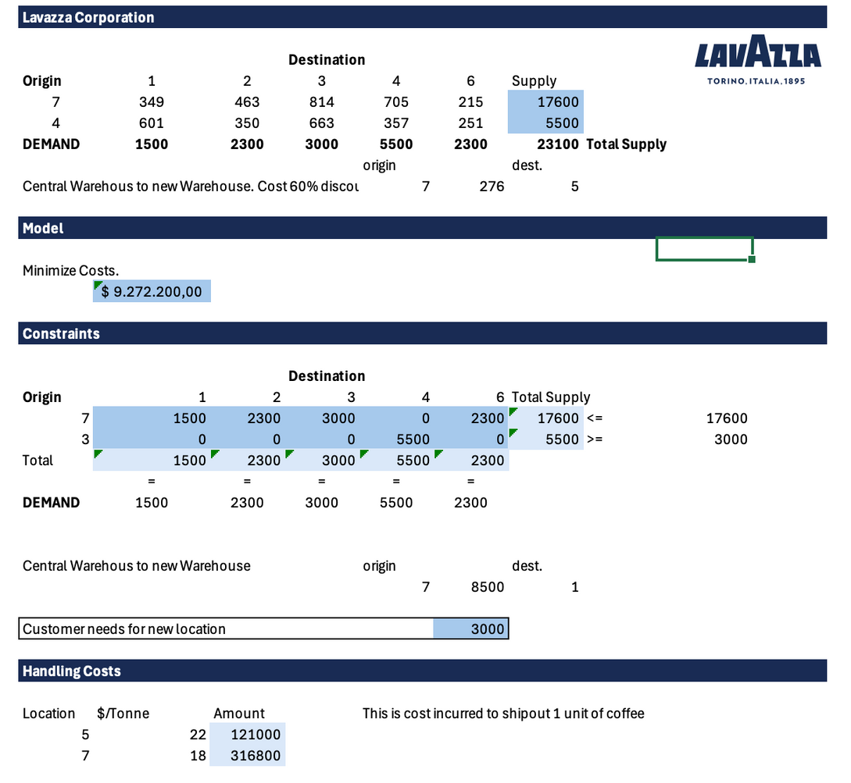
APPENDIX
EXPLAINING THE MODEL
Cost Structure
These are the costs of shipments per location from the new and main warehouse to the others. This number is larger than the initial 17600 because some units are shipped twice: once to location 2 and then again to the customer's location.
Objective Function
SUMPRODUCT(Total Shipments; Total Cost
Shipments by location)+(Discount costs for new warehouse * Shipments to new
warehouse)+SUM(Handling costs for new warehouse)
Constraints
This is the number of shipments from the main warehouses to the other locations, and the constraints for our model.
Handling Costs
The Handling costs incurred to ship out 1 unit of coffee

Slide 12
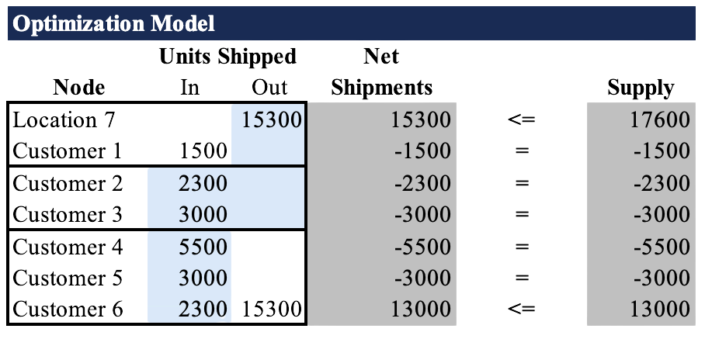
APPENDIX
TONNES DISTRIBUTION
TABLE 3: TONNES DISTRIBUTION
TABLE 4: TONNES DISTRIBUTION

Slide 13
REFERENCES
McKinsey & Company. (2021). Succeeding in the AI supply chain revolution. Retrieved from https://www.mckinsey.com/industries/metals-and-mining/our-insights/succeeding-in-the-ai-supply-chain-revolution?utm_source=chatgpt.com
MIT Sloan Review. (2023). Unlocking the potential of digital twins in supply chains. Retrieved from https://sloanreview.mit.edu/article/unlocking-the-potential-of-digital-twins-in-supply-chains/?utm_source=chatgpt.com
Lavazza. (n.d.). Lavazza logistics case study. Retrieved from https://www.lavazza.com/en
OpenAI. (2025). ChatGPT Model Analysis on Lavazza Logistics Optimization. Retrieved from OpenAI platform.

